Slide 1



Doctor Search Website
Milind Rathore
Indian Institute of Technology Ropar

Slide 2

Task Name: Develop a Doctor Search Website
Task Description:
In this task, we have to develop a Doctor Search Website. The objective of this task is to make you understand how to use Figma for designing web applications. How to export designs in HTML CSS using Locofy App. We will also create a doctors database and create web services to search doctors. Finally we have to integrate web services with front end. At last step you have to deploy the running project on a web server. You can use 000webhost.com to create a Free Server.

Slide 3
Agenda
Introduction
Tools and Techniques
Design of Project
Working of Project
Live Demo
References

Slide 4

Introduction
Doctor Search Website is a platform to find Doctors on various location in one click according to their respective needs.
Why do we need this website?
It provides the features that allow patients to book appointments online, this saves time and simplifies the process for patients without the need for phone calls or visiting.
It can be challenging to find the right healthcare professional for your specific needs. A website that showcases information about doctors, including their specialties, experience, and patient reviews, helps patients make informed decisions and find doctors who are best suited for their treatment.

Slide 5
Tools & Techniques
Design – For designing purpose we have used Figma tool.
Frontend – We have used HTML, CSS and JavaScript with the help of Locofy.ai tool to generate Front-end Code.
Backend – PHP language is used to create WebService and jQuery for connecting with the frontend.
Database – MySql database is used to store the data of doctors.
Hosting – For public hosting, we have used 000webhost.com platform.
Platform

Slide 6
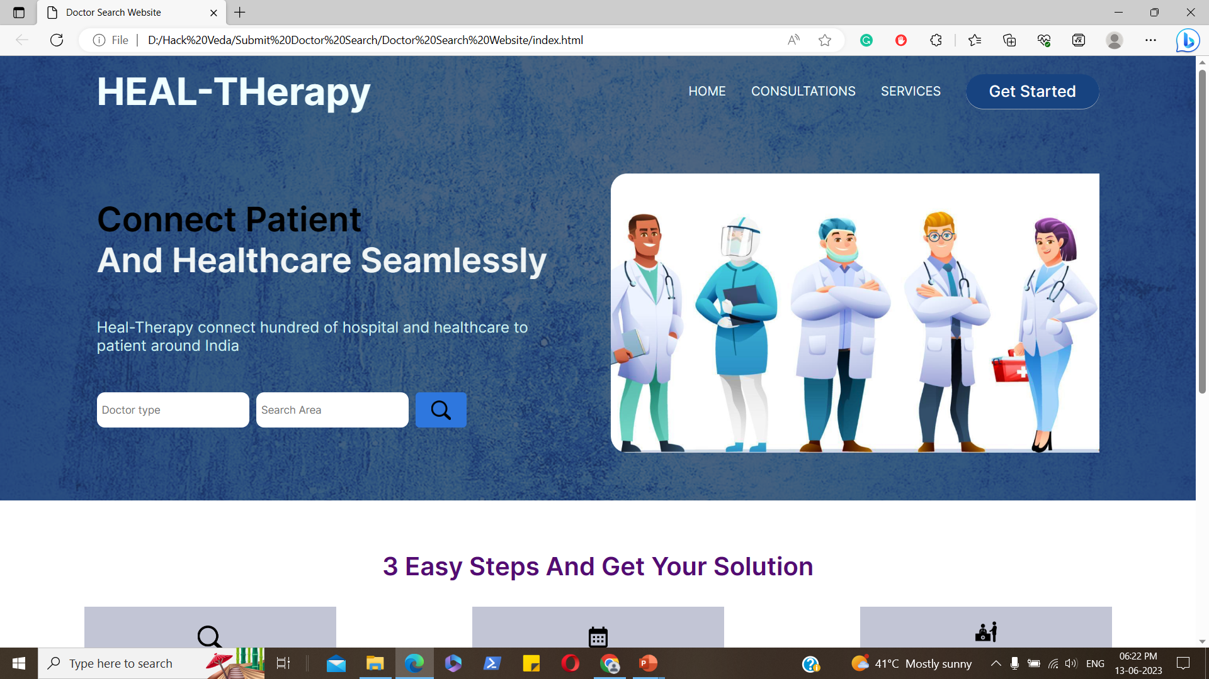
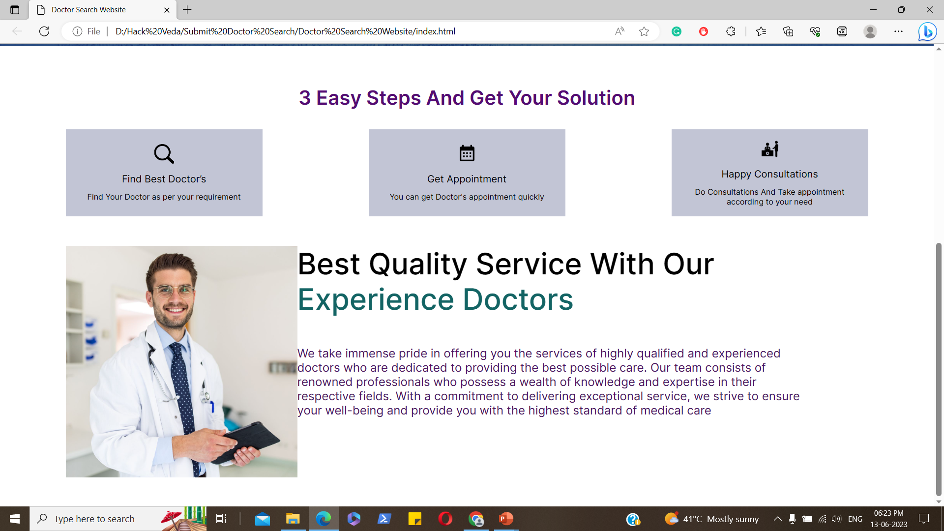
Design: By Figma
Navigation Bar
Search Button
Steps for getting Consultations
Information Regarding Qualities

Slide 7
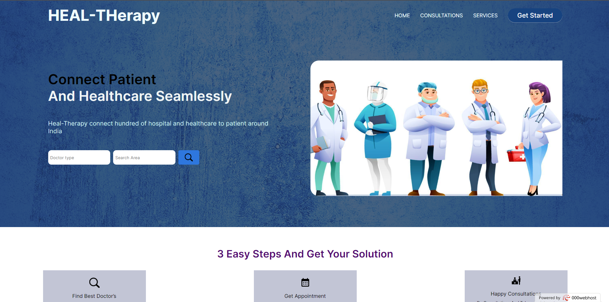
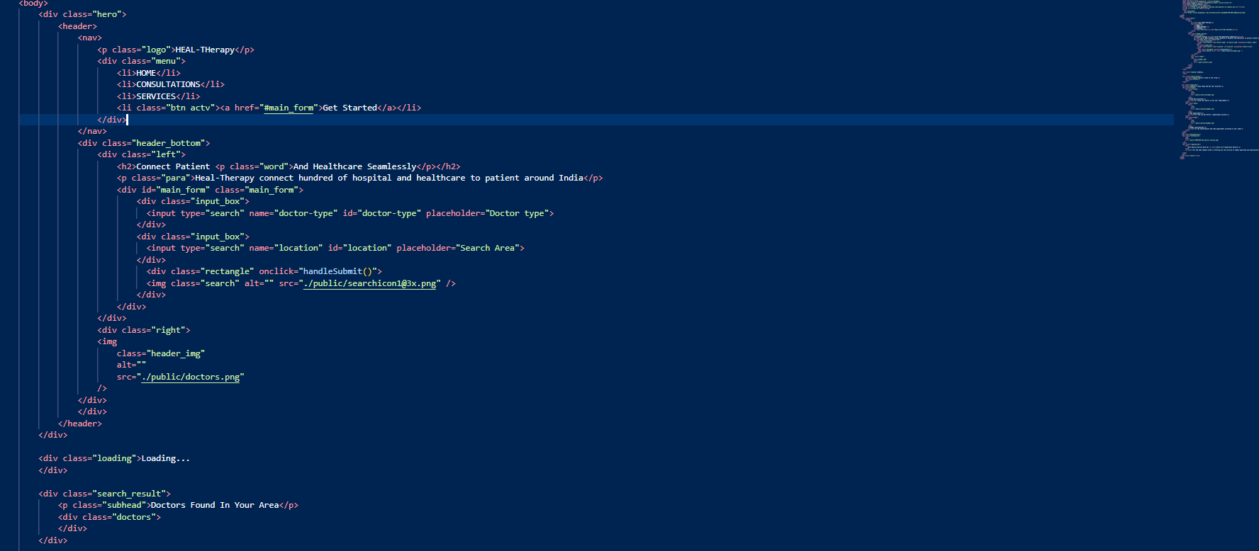
Locofy: Helps to export code from Website layout

Slide 8
Working of Project
After entering the details by user press search button.
Then a request will be sent to the backend through jQuery for doctors’ data.
Now backend web service will fetch doctor data from the database.
Now data will be sent to the backend web service.
From the backend web service, data will be fetched by jQuery and will show on the front end.

Slide 9
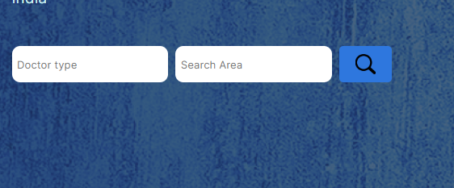


Enter Doctor type and Doctor area
Data fetching request to the backend
Data fetching from Database

Slide 10

Backend
PHP language is used to create WebService and jQuery for connecting with the frontend, allowing data exchange and interaction between the server and client sides of a web application. PHP serves as the server-side language, handling tasks such as processing requests, executing business logic, and interacting with databases. jQuery, on the other hand, is a JavaScript library that simplifies client-side scripting, making it easier to manipulate HTML elements, handle events, and perform asynchronous communication with the server using AJAX. Together, PHP and jQuery provide a robust and dynamic foundation for building responsive and interactive web services.

Slide 11

Database
MySql database is used to store the data of doctors, providing a reliable and efficient storage solution for organizing and managing information related to doctors. MySql is a popular open-source relational database management system that offers features such as data integrity, scalability, and robust performance. It allows for the creation of tables, defining relationships between them, and executing queries to retrieve, insert, update, and delete data. With MySql, the data of doctors can be securely stored, easily accessed, and efficiently manipulated, facilitating tasks such as searching for doctors, managing appointments, and maintaining accurate records.

Slide 12
Hosting Platform
Hosting Platform – For public hosting, we have used the 000webhost.com platform. 000webhost.com is a popular web hosting service that provides free hosting plans, allowing users to host their websites and web applications without incurring any costs. It offers features such as ample disk space, bandwidth, and a user-friendly control panel for managing files, databases, and other hosting settings. With 000webhost.com, users can deploy their PHP-based web services and associated components, such as the MySQL database for storing doctor data, in a publicly accessible environment. It provides a convenient solution for hosting projects and making them available to users on the internet.

